Slide 1
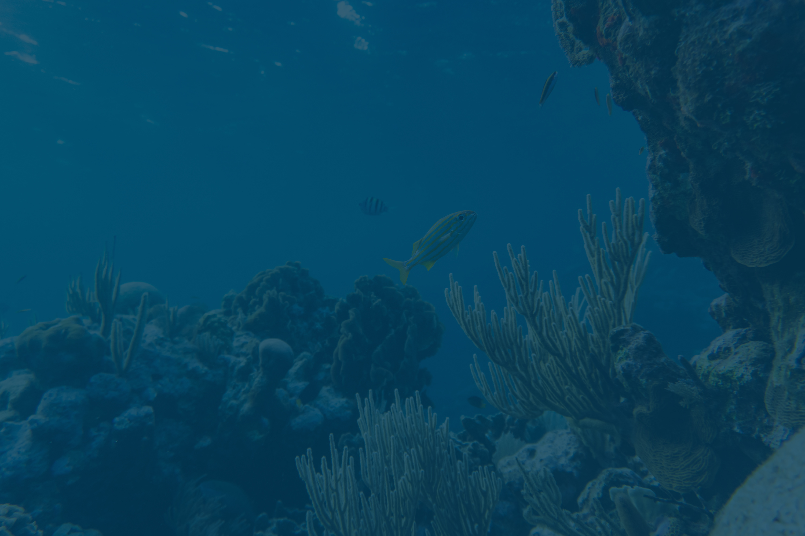





UNDERWATER VEHICLE DESIGN CHALLENGE
TEAM SUBNAUTICA

Slide 2
OVERVIEW
CHALLENGE OVERVIEW
Develop a Remotely Operated Vehicle (ROV) for exploring underwater caves and sinkholes
KEY FEATURES
3D Mapping: Advanced Sonar for terrain modeling in GPS-denied areas.
Anomaly Detection: Identifies hazardous conditions like volcanic vents.
Data Logging: Continuously records pH, temperature, pressure, and salinity.
In-situ Analysis: Analyzes soil and water samples for minerals and pollutants.
Mobility: Navigates turbulent underwater environments.
Ecological Safety: Ensures no disturbance to ecosystems.
Reliability: Designed for missions up to two days.
MISSION STATEMENT
Create a multifunctional ROV for advanced underwater exploration while prioritizing ecological safety and non-invasive studies.

Slide 3
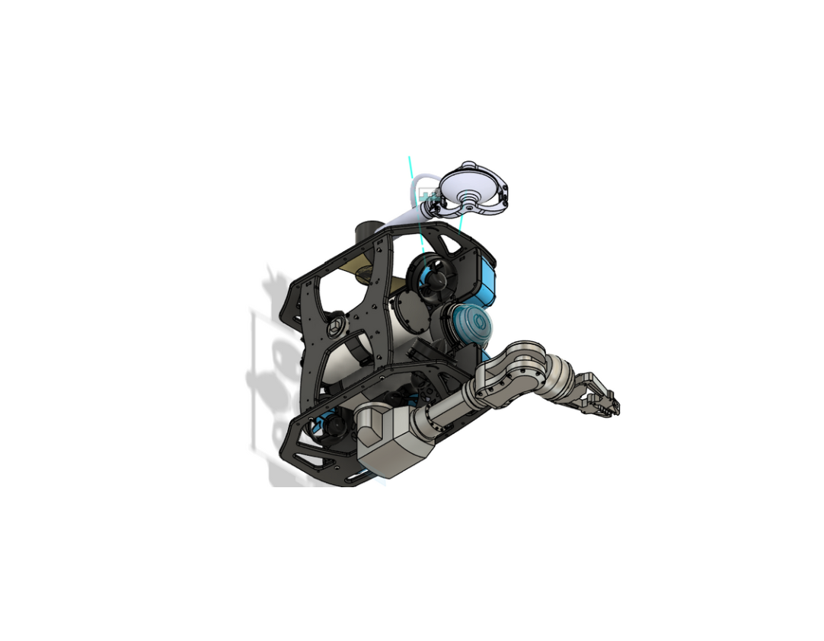
MECHANICS
FRAME STRUCTURE (DIAMOND-TYPE GEOMETRY)
Rectangular space-frame using anodized Al-6061-T6, with four corner uprights and top/bottom decks connected via cross-members and X-/K-bracing.
Indexed hard-points on the front ring and slotted rails on the lower deck for payload flexibility and CG tuning.
ELECTRONICS HOUSING (DUAL-CYLINDER DESIGN)
Central “main cylinder” comprises a 4-inch acrylic watertight tube with aluminum end caps, housing electronics and sensors.
Balanced pressure design: inner electronics cylinder suspended via an electronics tray (ABS + aluminum spacers) inside the outer tube, ensuring uniform pressure distribution and easy service access

Slide 4
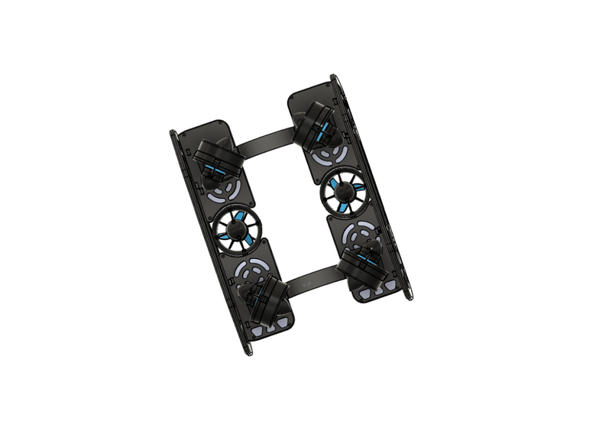
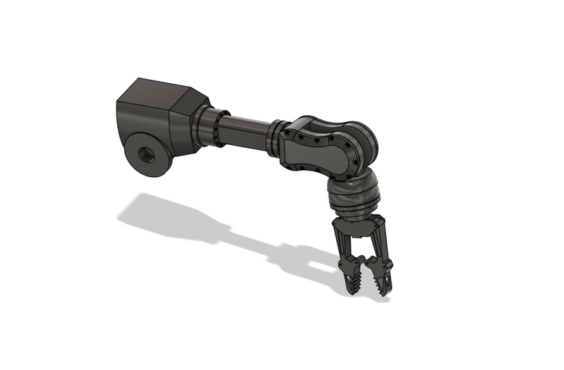
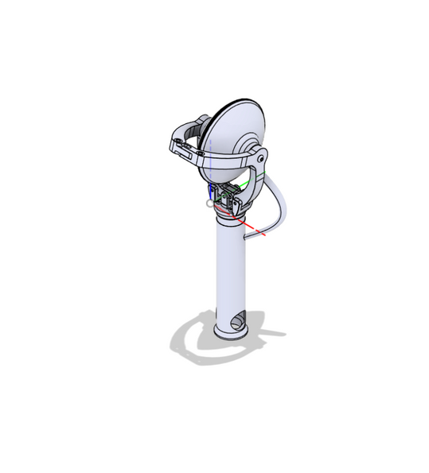
THRUSTER PLACEMENT
6-DOF vectored thrusters mounted on gusseted bosses:
Surge (forward/back): mid-height, 20–30° toe-in for
smooth navigation in narrow passages.
Sway (lateral): front-side mounts for fine side movement
control, with guards to protect against impact.
Heave (vertical): placed below the CG for stable vertical
motion and minimal pitch coupling.
DUAL MANIPULATOR ARMS
Left: Pincher arm: Two opposing jaws (like claws) operated by servo motors to pick up rocks, shells, or biological samples
Right: cup arm: Scooping mechanism at end with internal teeths to scratch off soil sample from hard surface
BALLAST & STABILITY CONTROL
Compact ballast tanks:
integrated at the base of the frame which serves as backup for thruster failure
Buoyancy foams:
Rigid, pressure resistant and retains trapped air inside water
Neutral buoyancy point, thus thrusters alone can be used for ascending and descending

Slide 5
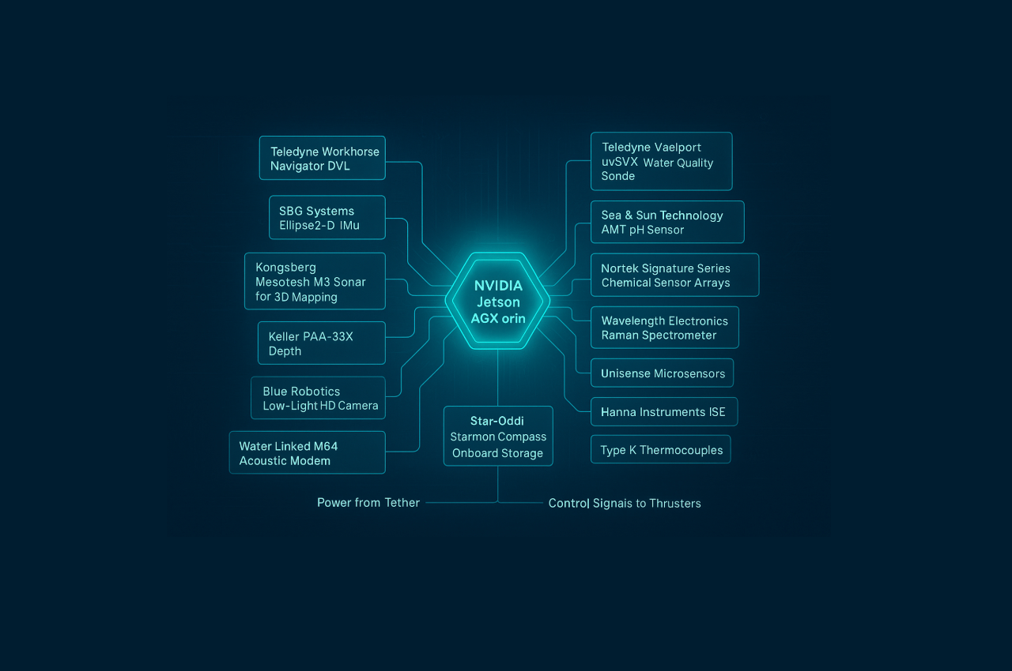
ELECTRONICS
SUBSYSTEM
Core Intelligence: The NVIDIA Jetson AGX Orin is the central processing unit, enabling autonomous navigation and data fusion.
Navigation & Mapping: A DVL, IMU, and Sonar Array provide precise navigation in GPS-denied environments and create 3D maps.
Environmental Analysis: A suite of sensors including a Water Quality Sonde, pH Sensor, Raman Spectrometer, and pXRF collect critical environmental and chemical data.
Vision & Data: An integrated low-light Camera provides visual feedback, with all data logged to onboard storage.

Slide 6
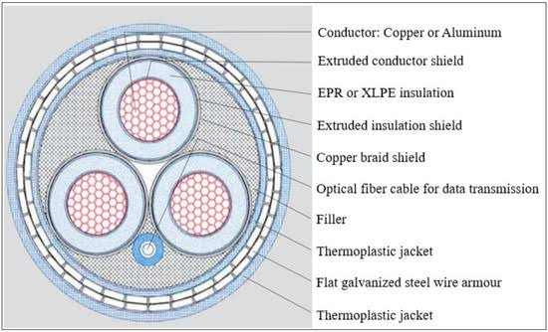
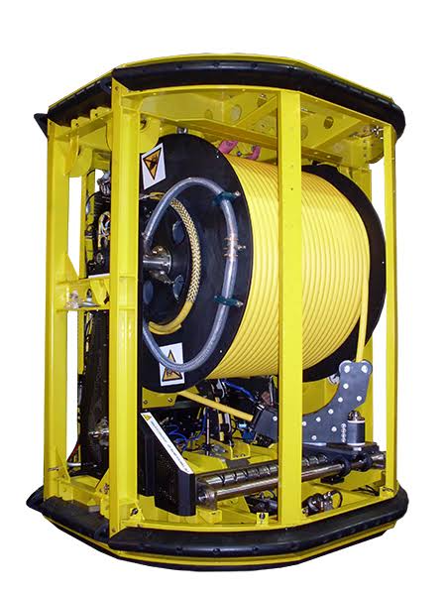
POWER & COMMUNICATION
POWER SYSTEM
Primary Source: A surface-supplied tether provides continuous power.
System Stability: Intelligent distribution with failsafe converters and real-time monitoring ensures regulated power to all subsystems.
Contingency: Upon tether failure, a backup battery initiates an automated ascent and recovery protocol.
COMMUNICATION SYSTEM
Primary Link: The hardwired tether provides a high-bandwidth, low-latency connection for robust real-time control and data telemetry.
Backup Link: An Acoustic Modem activates if the tether fails, transmitting distress signals to ensure vehicle recoverability.

Slide 7
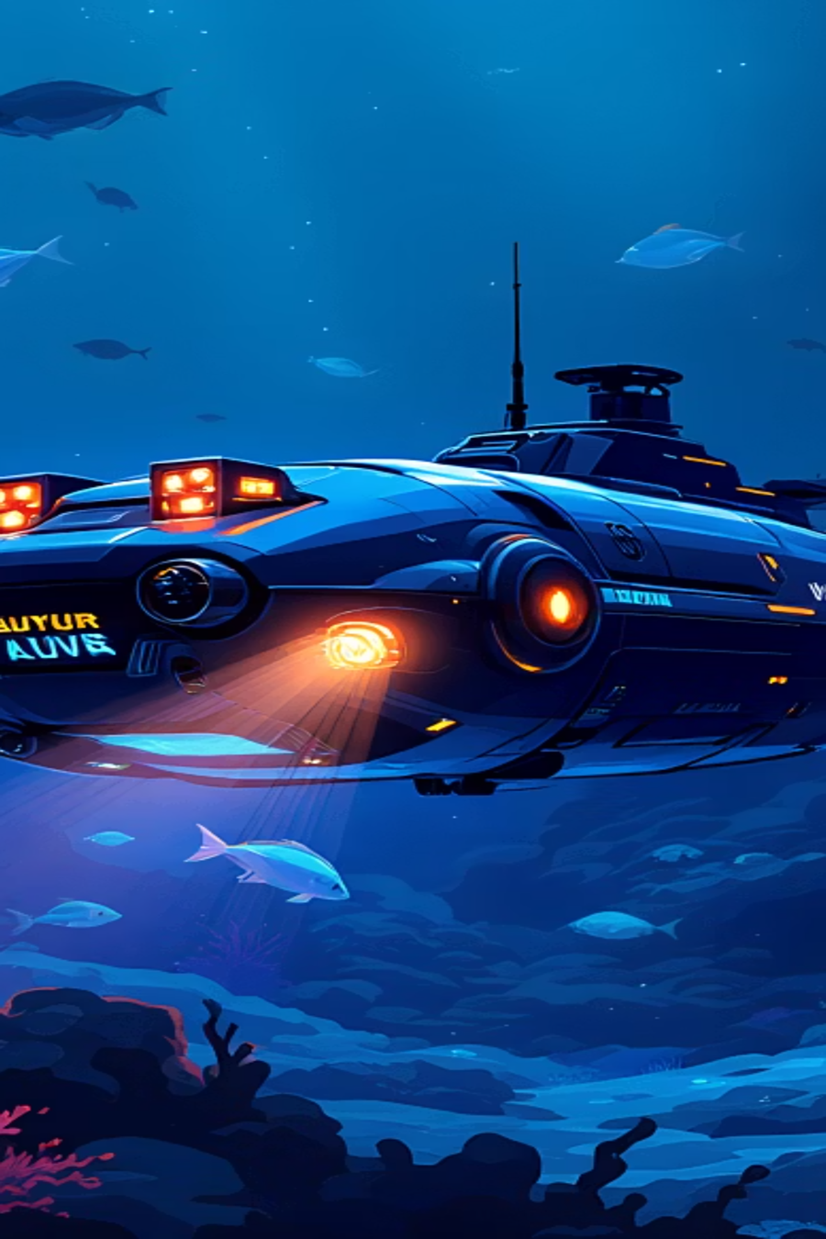
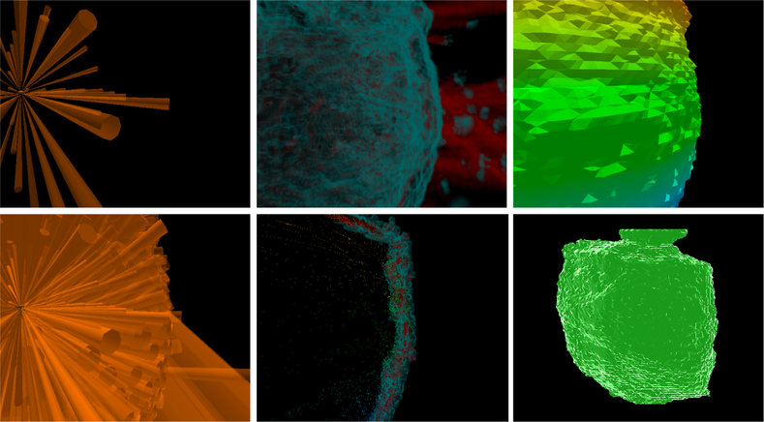

CAVE MAPPING AND RECONSTRUCTION
EXPLORING THE UNSEEN DEPTHS
REAL TIME 3D MAPPING
SENSORS FUSION FOR PRECISION
Our ROV utilizes a real-time 3D Simultaneous Localization and Mapping (SLAM) algorithm to continuously track its position while building intricate point cloud maps of GPS-denied underwater environments. This ensures a dynamic, high-resolution understanding of its surroundings.
Sonar Array: Provides near-360-degree acoustic data for continuous 3D map construction (range up to 200m).
IMU: Offers stable orientation and motion tracking for dead reckoning.
DVL: Corrects IMU drift with precise seafloor velocity measurements, maintaining positional integrity.
Sensor data fusion, probabilistic modeling, and iterative refinement ensure AUV receives a real-time, continually improving model of the exploration area. This process converts raw sonar point cloud data into a solid mesh model, providing a clear and comprehensive reconstruction of the underwater environment.

Slide 8
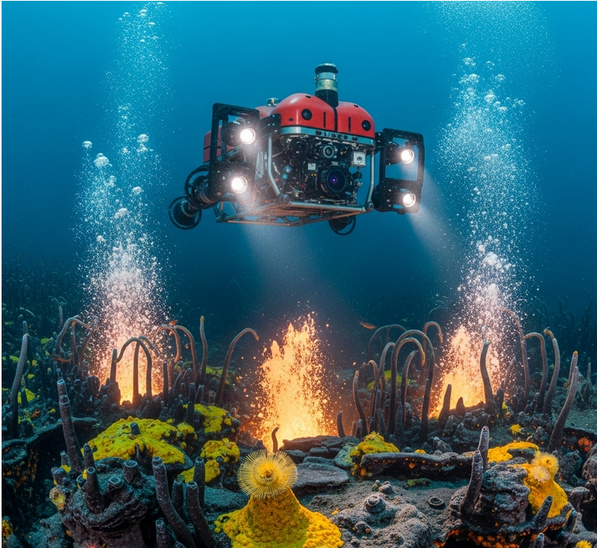
ANOMALY ANALYSIS
DETECTION
Thermal Sensors: Detect rapid temperature increases above 20∘C to identify volcanic vents.
pH Sensors: Signal acidic water by detecting a pH level below 6.0, often found near hydrothermal vents.
Chemical Sensors: Identify hazardous regions by detecting high concentrations (over 5 mM) of sulphide, a key indicator of hydrothermal vents.
AVOIDANCE
Vectoring Thruster Control: Uses six-degrees-of-freedom thrusters for immediate and precise course changes away from hazards.
Intelligent Path Planning: Dynamically reroutes the mission using a modified A* algorithm to find the safest and shortest alternative path.
Failsafe Protocol: Executes an emergency ascent or a pre-defined recovery program if no safe avoidance path is available.

Slide 9
DATA LOGGING
ONBOARD SYSTEM WORKLFOW
Our methodology is built around a real-time processing loop that runs continuously on the AUV during its autonomous survey.
SENSE
While navigating, the AUV's DVL and sonde constantly acquire raw data streams from the environment.
FUSE&
REFINE
The onboard NVIDIA Jetson processor immediately fuses these streams. The data is simultaneously filtered to remove sensor noise and anomalies.
ANALYSE&
MAP
The cleaned, fused data is instantly fed into our ROS 2 software stack. This performs environmental modeling and renders a detailed, layered map of the environment as it is being discovered.
The final, processed output—containing precise coordinates, water quality, and current vectors—is written to the onboard logger. This loop repeats at a high frequency throughout the mission.
LOG

Slide 10
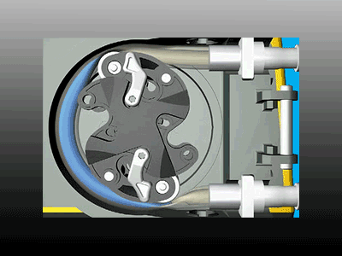
SOIL-WATER COLLECTION & ANALYSIS
INLET & SAMPLE HANDLING
ANALYSIS CHAMBER
1
2
Inlet pipe (1 cm ID, abrasion-resistant PTFE/Santoprene)
Peristaltic pump: draws 4–6 L/min, prevents backflow
Stone trap / pre-filter: captures >5 mm grains
Anodized Al - 6061 -T6, pressure-balanced for ~300 bar
Holds fixed slurry volume for in-situ study
Integrated sensors:
pH, Temperature
Ion-selective electrodes (NO₃⁻, NH₄⁺, Cl⁻, heavy metals)
Gas/chemical probes (O₂, H₂S, pollutants)
Raman + XRF → molecular & elemental composition
OUTLET & FLOW CONTROL
3
Second peristaltic pump discharges sample
Dual check valves = no contamination, no seawater intrusion
Cycle: Fill → Seal & Analyze → Expel

Slide 11
ENVIRONMENTAL SENSING & ANALYSIS
HYDROCARBON CONCENTRATION
MINERAL
ANALYSIS
DATA &
NAVIGATION
Ultrasonic Transducers: Measures oil slick thickness.
Laser Raman Spectrometer: Identifies specific oil types.
Chemical Sensor Arrays: Confirms presence of pollutants.
Microelectrodes: Analyzes dissolved mineral ions and gases directly from the sediment.
pXRF: Conducts on-site elemental analysis of rock and sediment samples.
Integrated Navigation (DVL/IMU): Tracks precise location.
Automated Sampling: Collects data on a programmed grid.
Data Logging: Creates a time-stamped, 3D georeferenced map.

Slide 12
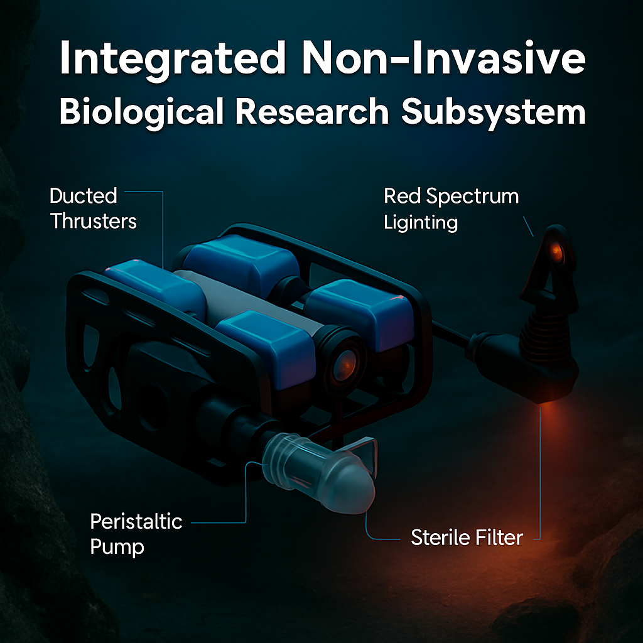
MARINE BIOLOGICAL ANALYSIS
KEY CONSTRAINTS
Minimal disturbance (hydrodynamic, acoustic, optical).
Non-contact eDNA collection with accurate tracking mechanism.
Functionality in turbid/low-light conditions.
SOLUTION
Remote Observation: Ultra-low-light imaging, multispectral filters, passive acoustics.
eDNA Sampling: Peristaltic pump with sterile filters.
Preservation: Sealed cassettes with unique IDs.
Low-Disturbance Operations: Ducted thrusters and red-spectrum lighting.
TECHNICAL IMPLEMENTATION
Architecture: Modular design with interchangeable pods.
Sensors: 4K low-light camera.
Fluidics: Pump for sterile water sampling with anti-contamination protocols.
Software: Automated sampling and data logging.

Slide 13
SUBSYTEM FAILURE & RECOVERY
COMMUNICATION FAILURE
POWER SYSTEM FAILURE
Problem: Lost link to surface.
Solution: Automated "Return to Surface" protocol triggers after a preset time.
Sensor: Communication Status Sensor.
Problem: Main power loss.
Solution: Redundant emergency battery powers essential systems (buoyancy, pinger).
Sensor: Voltage/Current Sensor.
SENSOR &
DATA FAILURE
SOFTWARE &
CONTROL FAILURE
Problem: Key sensor malfunction.
Solution: Mutiple sensors and a self-correction routine. Onboard non-volatile memory for data recovery.
Sensor: N/A (Software-based).
Problem: System crash or stall.
Solution: Watchdog timer initiates a system reset or triggers the emergency buoyancy system.
Sensor: Watchdog Timer / Acoustic Modem Signal Strength.

Slide 14
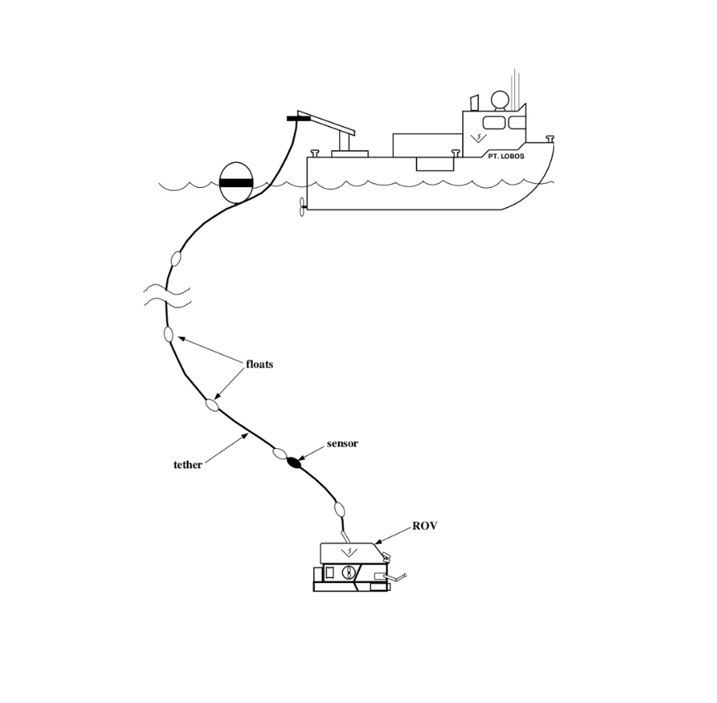
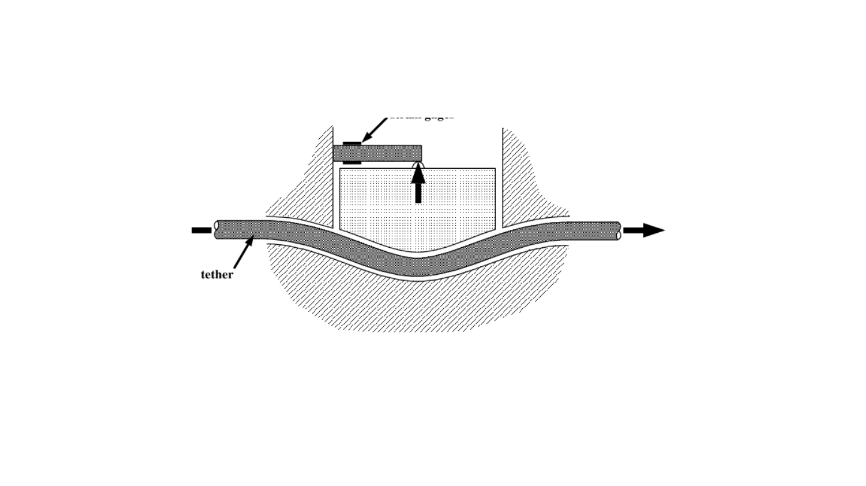
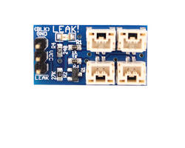
MOBILITY SYSTEM FAILURE
Problem: ROV stuck.
Solution: Use tether as tow line. Emergency tether release if snagged, followed by buoyancy ascent.
Sensor: Tether Tension Sensor.
TETHER SNAGS
Problem: Tether severed or permanently snagged.
Solution: Emergency tether release mechanism, followed by buoyancy ascent and separate recovery. Onboard battery for short-term power.
Sensor: N/A (Part of Mobility System Failure).
STRUCTURAL FAILURE
Problem: Water leak.
Solution: Sensors detect water ingress, triggering immediate buoyancy ascent.
Sensor: Water Leak Sensor.

Slide 15




LONG-TERM HABITAT MONITORING
HYPER-AUTONOMOUS MISSIONS
FUTURE PROSPECTS
ADAPTIVE DESIGN &
BIO-INSPIRED MOVEMENT
IMMERSIVE MIXED-REALITY CONTROL

Slide 16
THANK YOU
FOR YOUR ATTENTION

